Slide 1
Electrical Machines
By Dr. M. Chinna Obaiah,
Assistant Professor (Sr), SELECT, VIT Vellore.

Slide 2
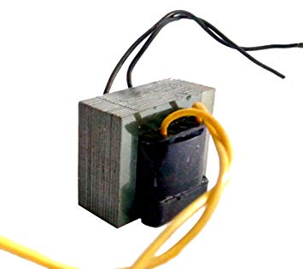
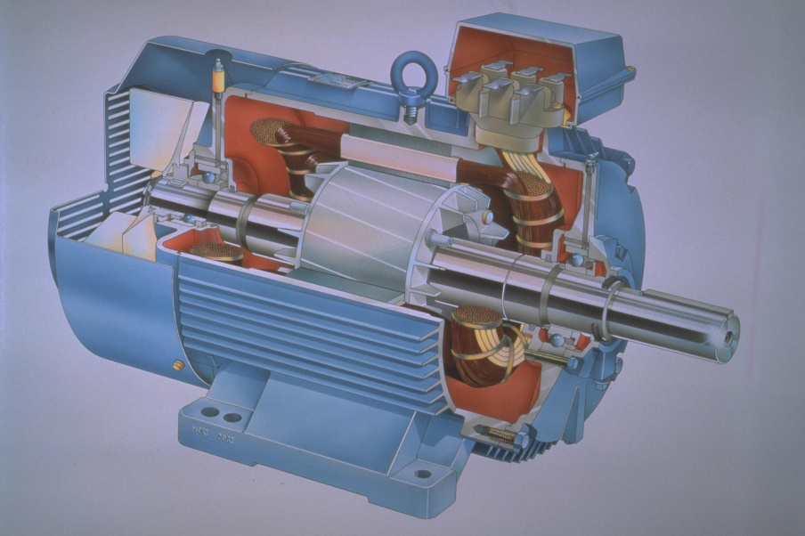
AC Machines
Transformers,
Induction motors
Synchronous motors

Slide 3
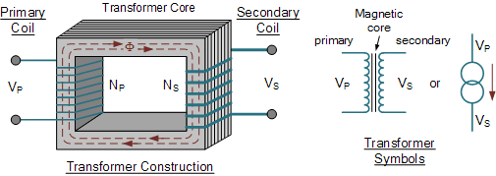
Transformers
Transformer is a static electromagnetic device designed to transform AC energy from one voltage level into another voltage level without altering the energy level (considering zero power loss).
Application: Transformers play a major role in electric power engineering and are a necessary part of the electric power transmission and distribution network.
Construction: A transformer consisting of two electrical circuits which are magnetically coupled by a common ferromagnetic core (silicon steel laminations) and permits a “transformation” of the voltage and current between one circuit and the other.
One coil is termed the primary winding which is connected to the supply of electricity, and
the other the secondary winding, which may be connected to a load.
3

Slide 4
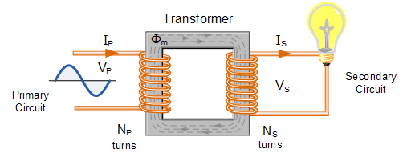
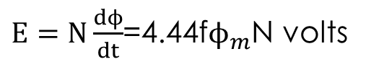
Working principle:
A transformer operates on the principles of mutual inductance, between two inductively conducted coils.
When the secondary is an open-circuit and an alternating voltage V_{p} is applied to the primary winding, a small current—called the no-load current I₀ —flows, which sets up a magnetic flux in the core.
This alternating flux links with both primary and secondary coils (N₁ and N₂ turns, respectively) and induces in them e.m.f.’s of E₁ and E₂ respectively by mutual induction.
The induced e.m.f. E in a coil of N turns is given by
$E=N\frac{dϕ}{dt}$=4.44f$ϕ_{m}$N volts
In an ideal transformer, the rate of change of flux is the same for both primary and secondary and thus E₁/N₁=E₂/N₂, i.e. the induced e.m.f. per turn is constant.
E₁
E₂
Assuming no losses, E₁=V_{p} and E₂=V_{s}. Hence
V_{p}/N₁ = V_{s}/N₂ or V_{p}/V_{s} = N₁/N₂
V_{p}/V_{s} is called the voltage ratio and N₁/N₂ the turns ratio, or the ‘transformation ratio’ of the transformer.
When a load is connected across the secondary winding, a current I_{s} flows.

Slide 5
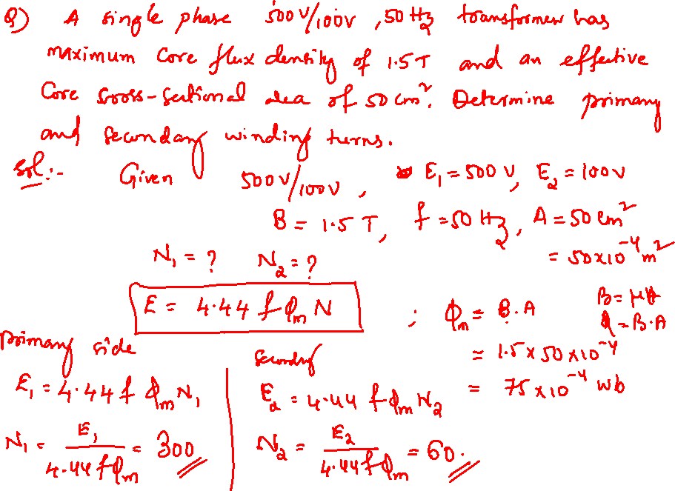

Slide 6
Three Phase Induction Motors
The induction motor is the most widely used electric machine, because of its relative simplicity of construction.
The primary advantage of the induction machine, which is almost exclusively used as a motor (its performance as a generator is not very good), is that no separate excitation is required for the rotor.
Three Phase IM is Self-starting.
It is basically an AC transformer with a rotating secondary
Most of the industrial loads are inductive, especially 3 phase induction motors (70%) are widely used in industrial applications for continuous operation.
Applications: pumps, compressors, conveyor belts, grinders.

Slide 7
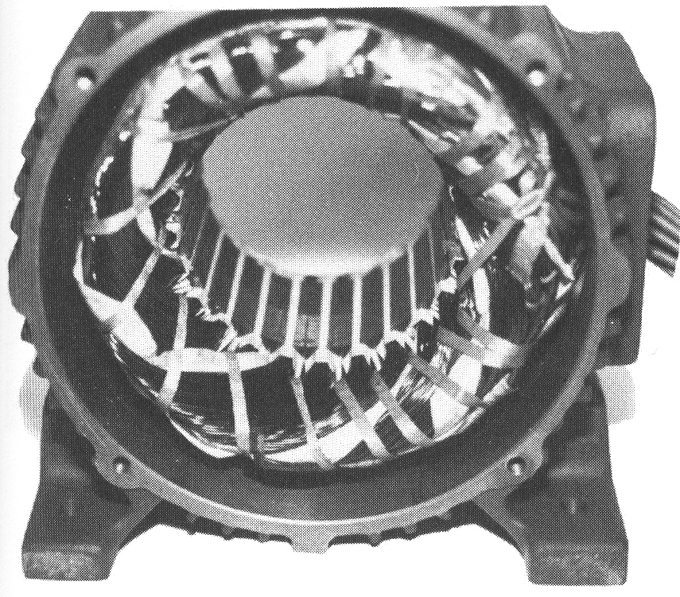
Construction
An induction motor has two main parts
a stationary stator
consisting of a steel frame that supports a hollow, cylindrical core
core, constructed from stacked laminations, having a number of evenly spaced slots, providing the space for the stator winding
Stator of IM

Slide 8
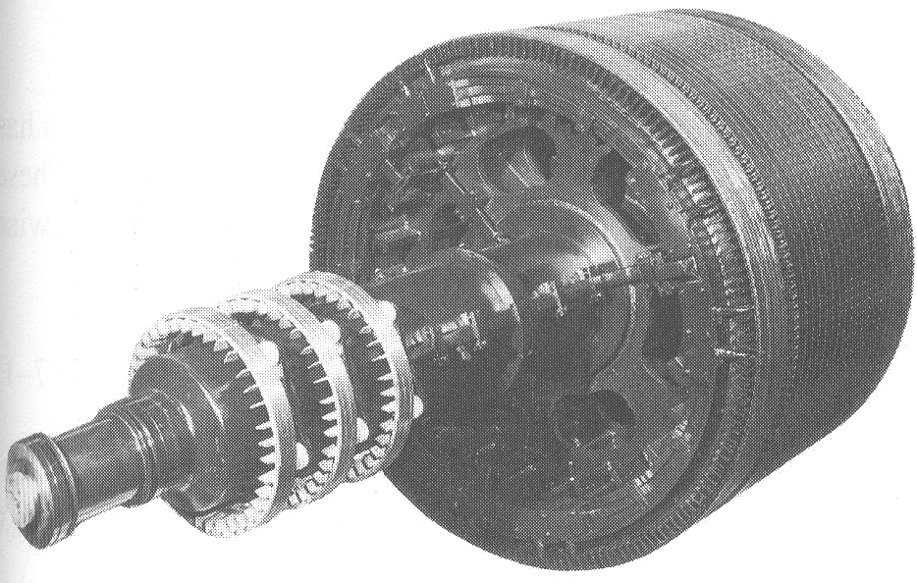
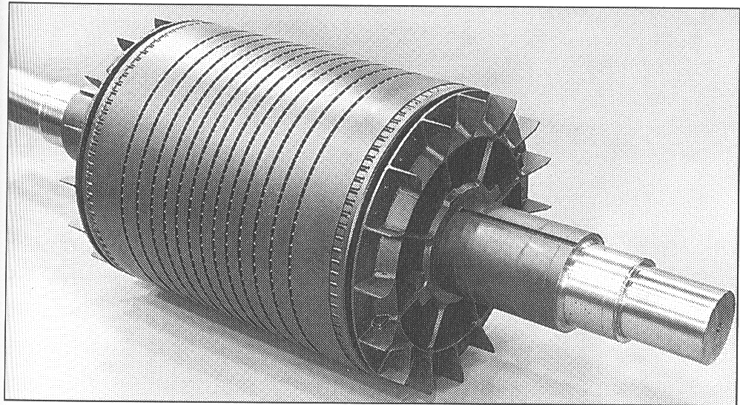
Construction
a revolving rotor
composed of punched laminations, stacked to create a series of rotor slots, providing space for the rotor winding
one of two types of rotor windings
conventional 3-phase windings made of insulated wire (wound-rotor) » similar to the winding on the stator
aluminum bus bars shorted together at the ends by two aluminum rings, forming a squirrel-cage shaped circuit (squirrel-cage)
Two basic design types depending on the rotor design
squirrel-cage Induction motor
wound-rotor Induction motor
Slip rings
Wound rotor
Squirrel cage rotor

Slide 9
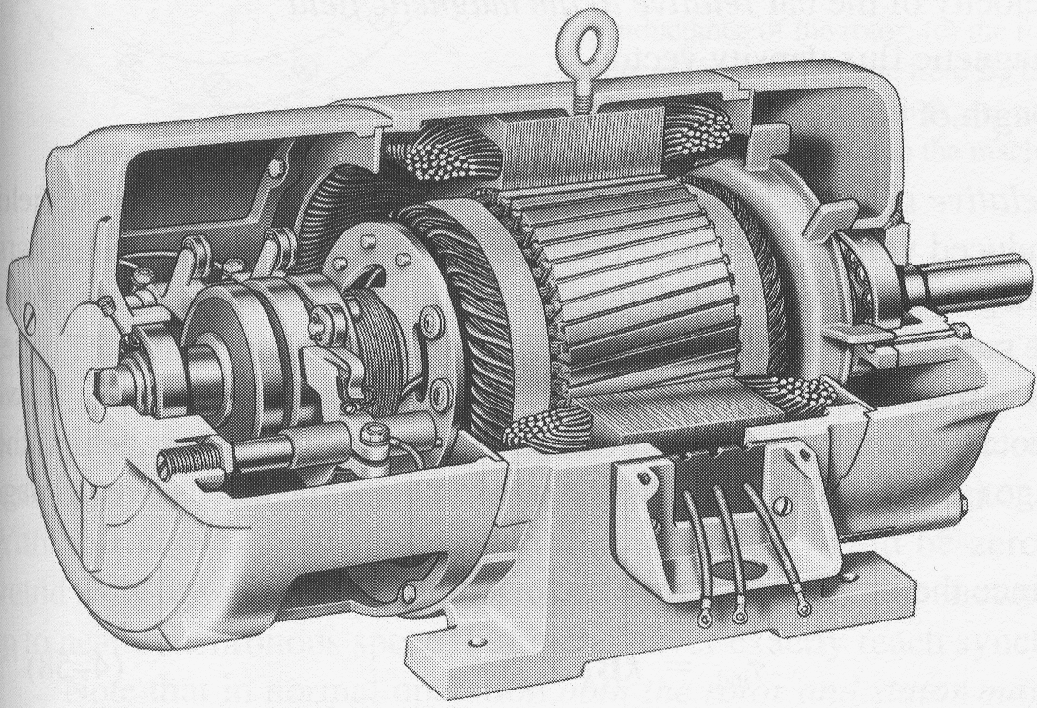
Cutaway in a typical wound-rotor Induction Motor.

Slide 10
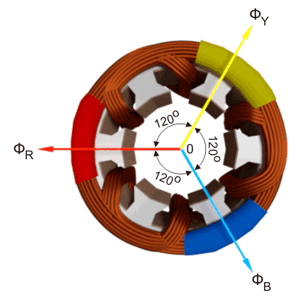
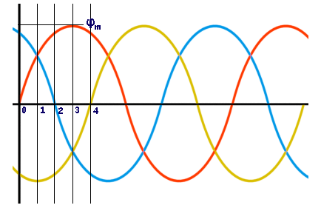
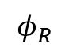
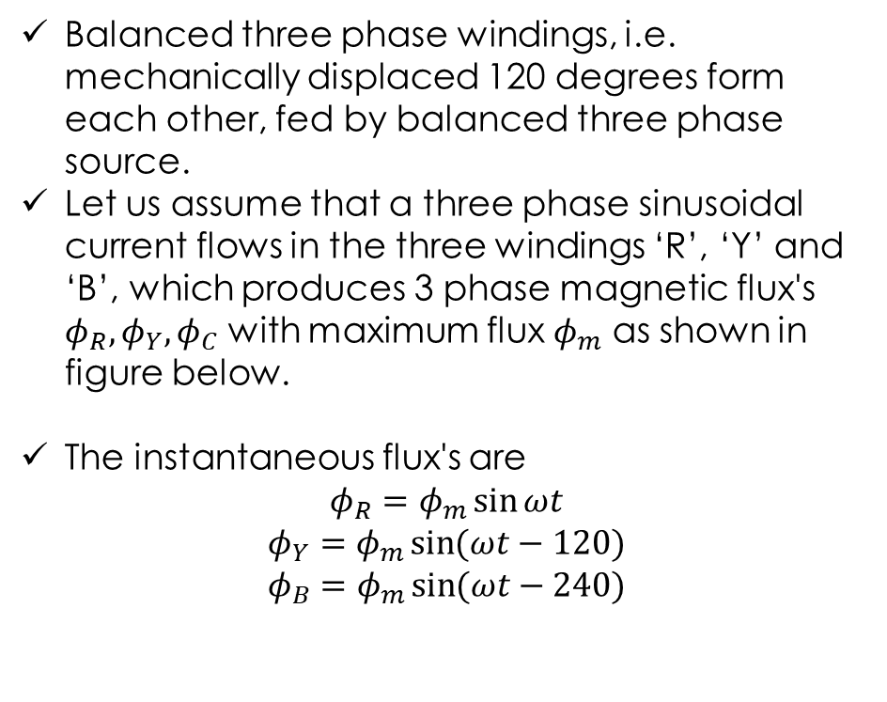
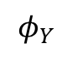
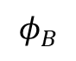
Rotating Magnetic Field
The operation of Three-Phase Induction motor and Synchronous motor is depending on the production of rotating magnetic field.
Balanced three phase windings, i.e. mechanically displaced 120 degrees form each other, fed by balanced three phase source.
Let us assume that a three phase sinusoidal current flows in the three windings ‘R’, ‘Y’ and ‘B’, which produces 3 phase magnetic flux's $φ_{R},φ_{Y},φ_{C}$ with maximum flux $φ_{m}$ as shown in figure below.
The instantaneous flux's are
$$φ_{R}=φ_{m}\sin{ωt}$$
$$φ_{Y}=φ_{m}\sin{(ωt−120)}$$
$$φ_{B}=φ_{m}\sin{(ωt−240)}$$
$$φ_{Y}$$
$$φ_{B}$$
$$φ_{R}$$
Notes:
The operation of Three-Phase Induction motor and Synchronous motor is depending on the rotating magnetic field.

Slide 11
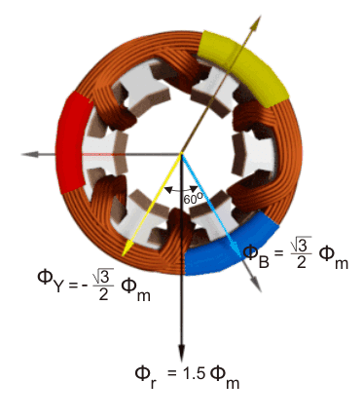
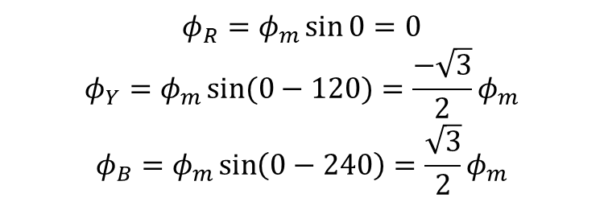

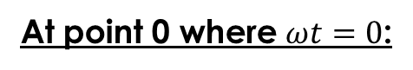
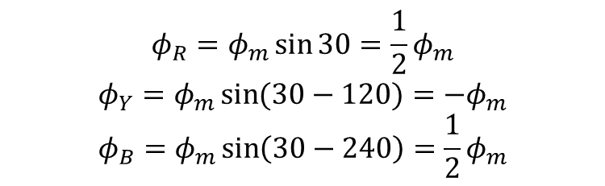
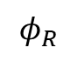
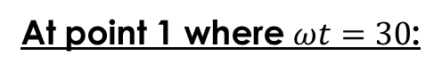
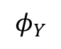
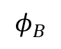

$$φ_{Y}$$
$$φ_{B}$$
$$φ_{R}$$
At point 0 where $ωt=0$:
$$φ_{R}=φ_{m}\sin{0}=0$$
$$φ_{Y}=φ_{m}\sin{(0−120)}=\frac{−\sqrt{3}}{2}φ_{m}$$
$$φ_{B}=φ_{m}\sin\left(0−240\right)=\frac{\sqrt{3}}{2}φ_{m}$$
The resultant flux $φ_{r}$ from parallelogram law of vector addition: $φ_{r}=1.5φ_{m}$.
At point 1 where $ωt=30$:
$$φ_{R}=φ_{m}\sin{30}=\frac{1}{2}φ_{m}$$
$$φ_{Y}=φ_{m}\sin{(30−120)}=−φ_{m}$$
$$φ_{B}=φ_{m}\sin\left(30−240\right)=\frac{1}{2}φ_{m}$$
The resultant flux $φ_{r}$ is: $φ_{r}=1.5φ_{m}$

Slide 12
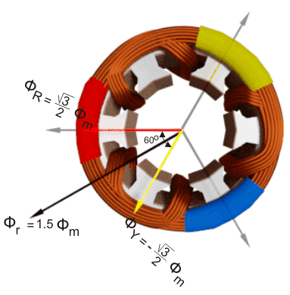
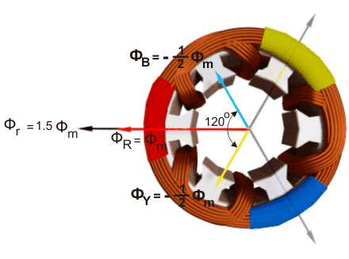

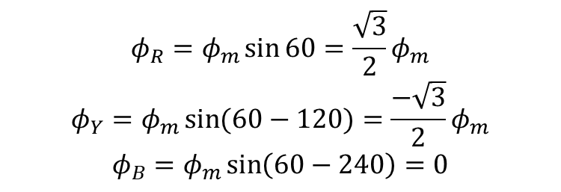
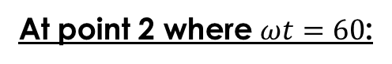
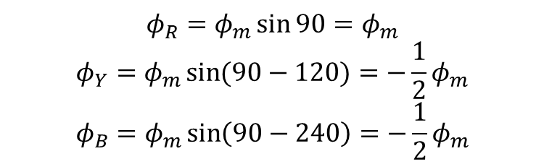
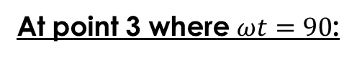
$$φ_{Y}$$
$$φ_{B}$$
$$φ_{R}$$
At point 2 where $ωt=60$:
$$φ_{R}=φ_{m}\sin{60}=\frac{\sqrt{3}}{2}φ_{m}$$
$$φ_{Y}=φ_{m}\sin{(60−120)}=\frac{−\sqrt{3}}{2}φ_{m}$$
$$φ_{B}=φ_{m}\sin\left(60−240\right)=0$$
The resultant flux $φ_{r}$ is: $φ_{r}=1.5φ_{m}$.
At point 3 where $ωt=90$:
$$φ_{R}=φ_{m}\sin{90}=φ_{m}$$
$$φ_{Y}=φ_{m}\sin{(90−120)}=−\frac{1}{2}φ_{m}$$
$$φ_{B}=φ_{m}\sin\left(90−240\right)=−\frac{1}{2}φ_{m}$$
The resultant flux $φ_{r}$ is: $φ_{r}=1.5φ_{m}$

Slide 13
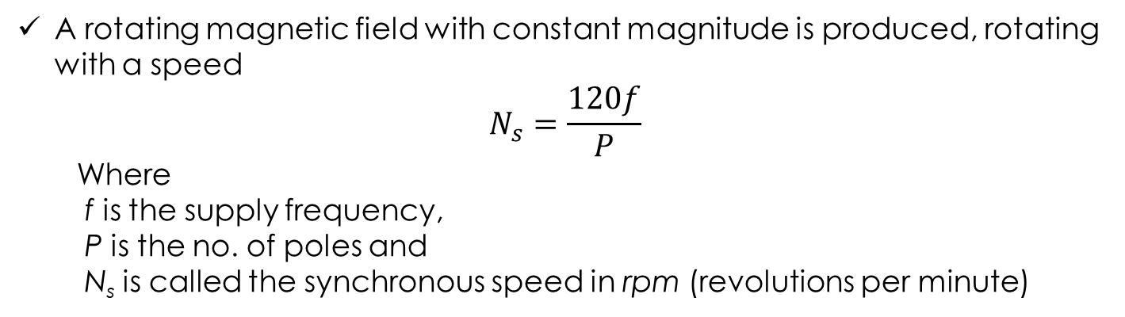
From point 0 to 3, r.m.f rotates 90. So for 2-pole induction machine, one cycle of the current make one revolution of the r.m.f. field.
For 4-pole IM, two cycles of the current make one revolution of r.m.f.
From this we can find the speed of the r.m.f, i.e.
Cycles of current = P/2 x revolution of r.m.f.
Cycles of current/sec = P/2 x revolution of r.m.f./sec
f = P/2 x (N_{s}/60)
A rotating magnetic field with constant magnitude is produced, rotating with a speed
$$N_{s}=\frac{120f}{P}$$
Where
f is the supply frequency,
P is the no. of poles and
N_{s} is called the synchronous speed in rpm (revolutions per minute)

Slide 14
Principle of operation
This rotating magnetic field cuts the rotor windings and produces an induced voltage in the rotor windings
Due to the fact that the rotor windings are short circuited, for both squirrel cage and wound-rotor, and induced current flows in the rotor windings
The rotor current produces another magnetic field
A torque is produced as a result of the interaction of those two magnetic fields
At what speed will the IM run?
Can the IM run at the synchronous speed, why?
If rotor runs at the synchronous speed, which is the same speed of the rotating magnetic field, then the rotor will appear stationary to the rotating magnetic field and the rotating magnetic field will not cut the rotor. So, no induced current will flow in the rotor and no rotor magnetic flux will be produced so no torque is generated and the rotor speed will fall below the synchronous speed
When the speed falls, the rotating magnetic field will cut the rotor windings and a torque is produced

Slide 15
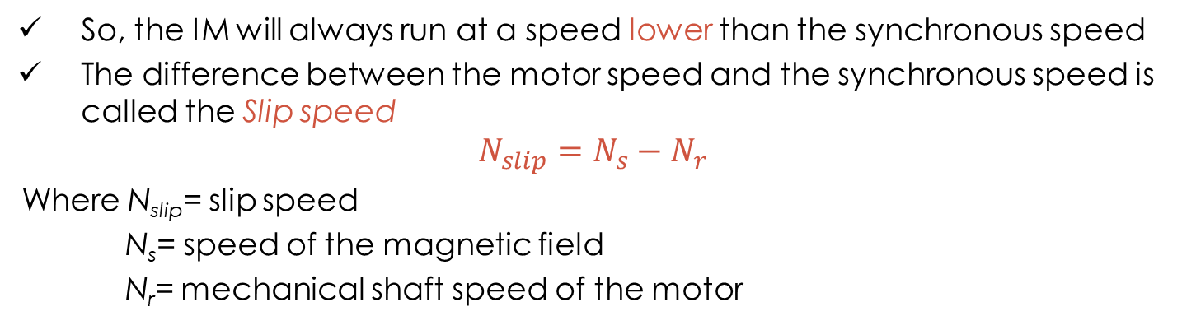
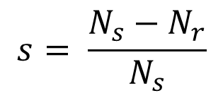
Induction motor speed
So, the IM will always run at a speed lower than the synchronous speed
The difference between the motor speed and the synchronous speed is called the Slip speed
$$N_{slip}=N_{s}−N_{r}$$
Where N_{slip}= slip speed
N_{s}= speed of the magnetic field
N_{r}= mechanical shaft speed of the motor
The Slip:
$$s= \frac{N_{s}−N_{r}}{N_{s}}$$
Where s is the slip
Note: if the rotor runs at synchronous speed: s = 0
if the rotor is stationary: s = 1
Slip may be expressed as a percentage by multiplying the above eq. by 100, notice that the slip is a ratio and doesn’t have units

Slide 16
Single Phase Induction Motors
The rotor in single phase induction motor is of squirrel cage rotor type.
The construction of single phase induction motor is almost similar to the squirrel cage three phase motor except that in case of asynchronous motor the stator have two windings instead of one as compare to the single stator winding in three phase induction motor.
Due to the stator winding is fed from a single-phase supply, the flux in the air gap is alternating only, not a synchronously rotating one produced by a poly-phase (may be two- or three-) winding in the stator of IM.
This type of alternating field cannot produce a torque , if the rotor is stationery.
So, a single-phase IM is not self-starting, unlike a three-phase one.
However, if the rotor is initially given some torque in either direction, then immediately a torque is produced in the motor.

Slide 17
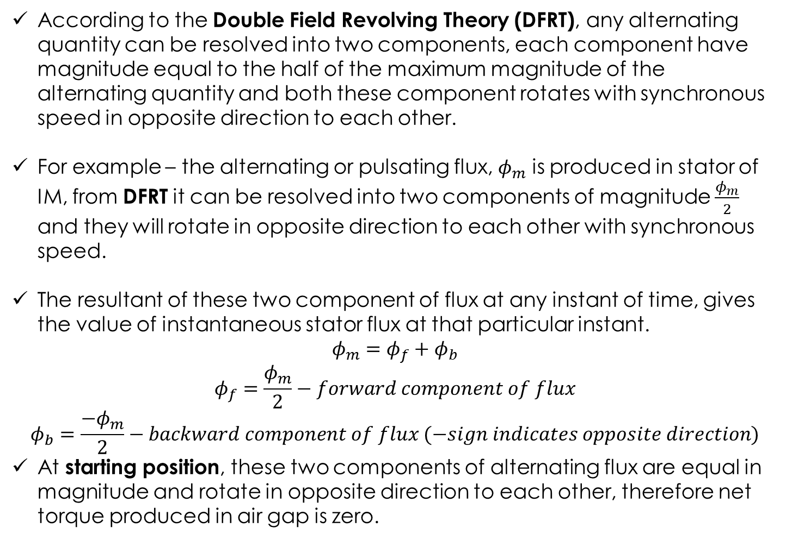
Why Single Phase Induction Motor is not Self Starting?
According to the Double Field Revolving Theory (DFRT), any alternating quantity can be resolved into two components, each component have magnitude equal to the half of the maximum magnitude of the alternating quantity and both these component rotates with synchronous speed in opposite direction to each other.
For example – the alternating or pulsating flux, $φ_{m}$ is produced in stator of IM, from DFRT it can be resolved into two components of magnitude $\frac{φ_{m}}{2}$ and they will rotate in opposite direction to each other with synchronous speed.
The resultant of these two component of flux at any instant of time, gives the value of instantaneous stator flux at that particular instant.
$$φ_{m}=φ_{f}+φ_{b}$$
$$φ_{f}=\frac{φ_{m}}{2}−forward component of flux$$
$$φ_{b}=\frac{−φ_{m}}{2}−backward component of flux (−sign indicates opposite direction)$$
At starting position, these two components of alternating flux are equal in magnitude and rotate in opposite direction to each other, therefore net torque produced in air gap is zero.

Slide 18
Starting methods of Single Phase IM
The single-phase IM has no starting torque, but has resultant torque, when it rotates at any other speed, except synchronous speed.
To produce rotating magnetic field in single phase IM of stator, it is required to introduce auxiliary winding at a space angle of 90º in addition to the main winding.
To produce a maximum starting torque, the current at the main and auxiliary windings must be at the angle of 90^{o.}
The various starting methods used in a single-phase IM are:
Resistance Split-phase Motor
Capacitor-start Motor
Capacitor-start and Capacitor-run Motor
Capacitor Split-phase Motor
Shaded-pole Motor

Slide 19
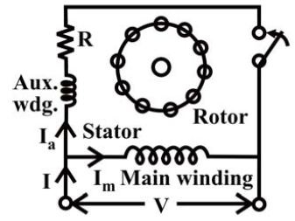
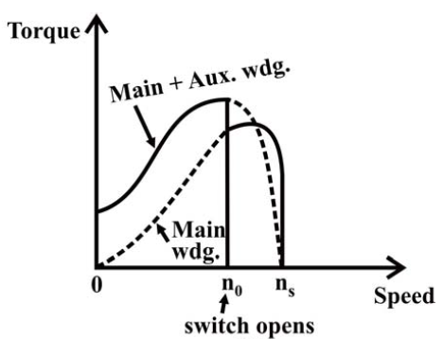
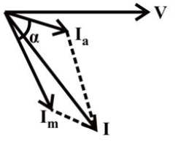
Resistance Split-phase Motor
Auxiliary winding resistance is high compared to main winding.
The switch, S (centrifugal switch) is in series with the auxiliary winding. It automatically cuts out the auxiliary or starting winding, when the motor attains a speed close to full load speed.
Applications: fan, saw, small lathe, centrifugal pump, blower, office equipment, washing machine, etc.
Schematic diagram
torque-speed characteristics
phasor diagram

Slide 20
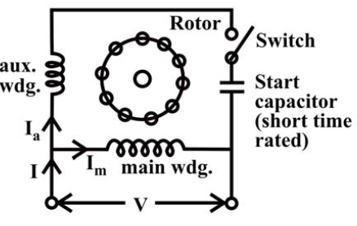
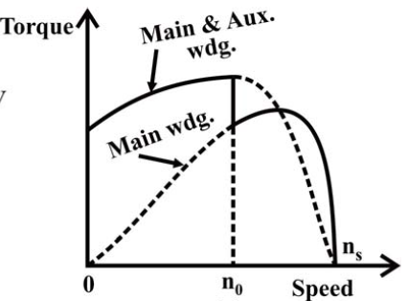
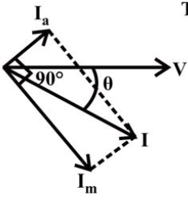
Capacitor-start Motor
A capacitor along with a centrifugal switch is connected in series with the auxiliary winding.
Applications: compressor, conveyor, machine tool drive, refrigeration and air-conditioning equipment, etc.
Schematic diagram
torque-speed characteristics
phasor diagram

Slide 21
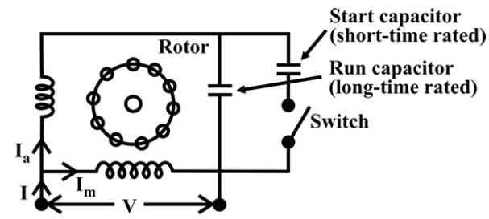
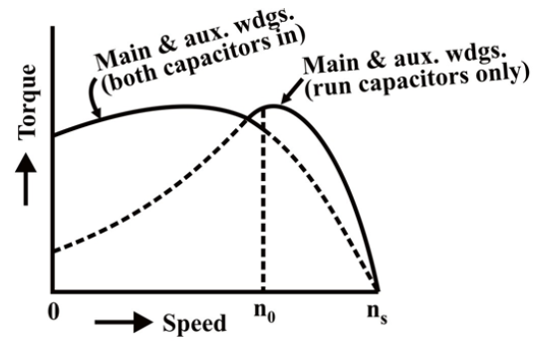
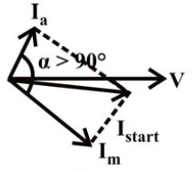
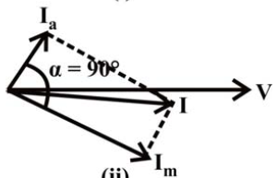
Capacitor-start and Capacitor-run Motor
two capacitors − C₁ for starting, and C₂ for running, are used
The efficiency of the motor is higher.
Applications: compressor, refrigerator, etc.

Slide 22
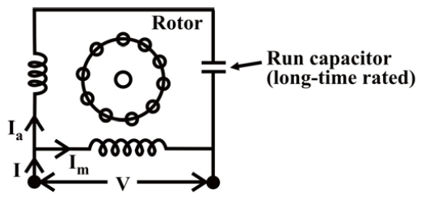
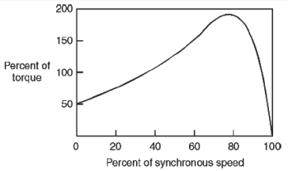
Capacitor Split-phase Motor
A capacitor is connected in series with the auxiliary winding.
Applications:
ceiling fans, air circulator, blower, etc.

Slide 23
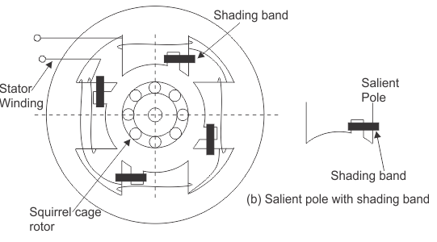
Shaded-pole Motor
The stator of the shaded pole single phase induction motor has salient or projected poles.
These poles are shaded by copper band or ring which is inductive in nature. The poles are divided into two unequal halves.
The smaller portion carries the copper band and is called as shaded portion of the pole.
The flux in shaded pole lags behind the flux in the unshaded pole. The phase difference between these two fluxes produces resultant rotating flux.
The direction of this field is from non shaded part of the pole to the shaded part of the pole.
Applications: These motors are only suitable for low power applications e.g., to drive: small fans, Toys, Hair driers, Desk fans etc.
The power rating of such motors is upto about 30 W.

Slide 24
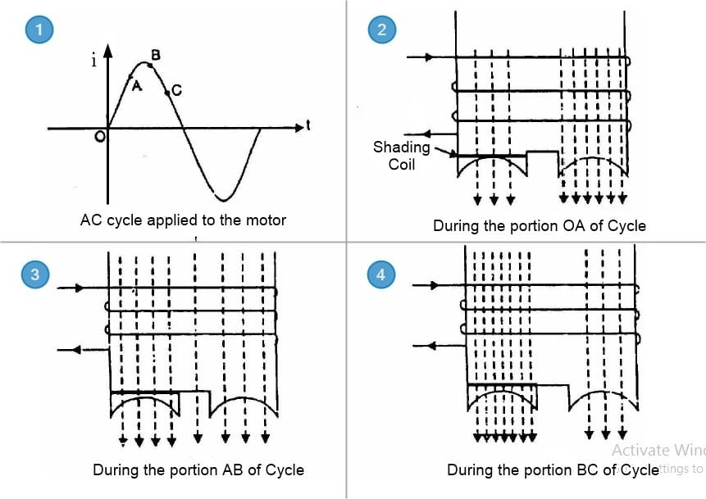
On starting, a current is induced into the shaded poles from the main poles by transformer action. The shading coils establish a magnetic field which is out of phase with that established by the main fields and a shifting field is produced sufficient to give the desired starting torque. When current is induced into the shading coils, a flux is built up which opposes the flux which produces it.

